Slide 1

Staying Secure with NuGet

Slide 2
Think of it this way...
We download code
From the internet
Written by unknown individuals
That we haven't read
Which we execute
With full permissions
On our trusted devices
Where we keep our most important data
Its a miracle that this all works!

Slide 3
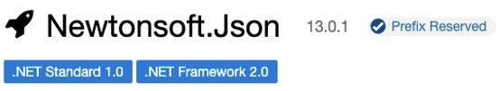
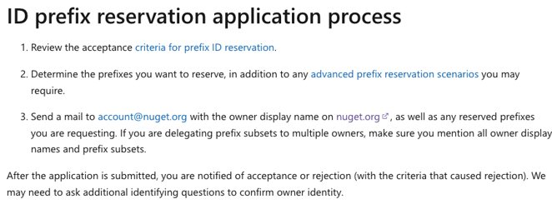
Typosquatting
Packages that use common misspellings or typos
Newtonsoft.Json
Newtosofts.Json
Package owners can reserve and protect their identity by reserving ID prefixes
Prefixes that are reserved are officially requested and accepted by the NuGet team

Slide 4
Dependency Confusion
Contoso.Input (NuGet.org)
Contoso.Input (Private Registry)
Attackers will ship malicious package updates on the unclaimed "Contoso.Input" package on the public registry to confuse package manager tooling to update the package to a compromised state
Use package source mapping to ensure you only download packages from a specific source

Slide 5
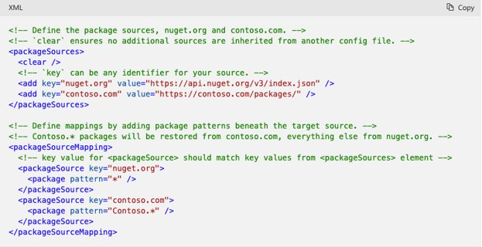
Package Source Mapping
Currently can be enabled for projects in Visual Studio Code my manually editing a nuget.config file in your project
Package source mapping centrally declare which source each package in your solution should restore from in your nuget.config file
Helps to prevent against dependency confusion

Slide 6
Hijacked accounts
Criminals and thieves find ways to control and infect popular packages with malicious programs like cryptocurrency miners
How?
Maintainers choose weak passwords
Maintainers reuse passwords
Maintainers get malware on their devices
NuGet requires two-factor authentication for all accounts

Slide 7
Dependency Management and NuGet Restore
NuGet Restore
Running dotnet restore will produce a report of security vulnerabilities with the affected package name, the severity of the vulnerability, and a link to the advisory for more details.
What to do if a vulnerability is found in one of your dependencies?

Slide 8
Security Vulnerabilities found with updates
If security vulnerabilities are found and updates are available for the package, you can either:
Edit the .csproj or other package version location (Directory.Packages.props) with a newer version containing a security fix.
Use the NuGet package manager user interface in Visual Studio to update the individual package.
Run the dotnet add package command with the respective package ID to update to the latest version.

Slide 9
Security Vulnerabilties found with no updates
In the case that a known vulnerability exists in a package without a security fix, you can do the following.
Check for any mitigating factors outlined in the advisory report.
Use a suggested package if the package is marked deprecated or is abandoned.
If the package is open source, consider contributing a fix.
Open an issue in the package's issue tracker.

